Slide 1
What’s New in C# 6
by Joe Mayo

Slide 2
Overview
New Language Features
IDE Improvements
Analysis and Debugging

Slide 3
History
Version 1: Full Object-Oriented Language
Version 2: Generics
Version 3: LINQ
Version 4: Dynamic
Version 5: Async
Version 6: Clean Code Enhancements and Roslyn

Slide 4
New Language Features
Auto-Property Initializers
String Interpolation
Static using Clauses
Index Initializers
Expression Bodied Function Members
Null Conditional Operator
nameof Operator
Exception Filters

Slide 5
Auto-Property Initializers
Set in class instance
Can be readonly
Initialize like a field
public virtual decimal Price { get; set; } = 3.00m;

Slide 6
String Interpolation
$ prefix
Replace format specifiers
Can hold expressions
Familiar formatting available
string menuItem = $"Name: {pizza.Name}, Price: {pizza.Price}";

Slide 7
Static using Clauses
Shorter syntax for common classes
using static System.Console;
class Program
{
static void Main()
{
WriteLine("Hello!");
ReadKey();
}
}
Notes:
6666666666666666666666666666666666666666666666666666666666666666666666666666666666666666666666666666666666666666666666666666666666666666666

Slide 8
Index Initializers
Convenient syntax for dictionaries
public Dictionary<string, float> IngredientAmounts =
new Dictionary<string, float>
{
["dough"] = 1.2f,
["cheese"] = .5f,
["sauce"] = .45f
};

Slide 9
Expression Bodied Function Members
Short syntax for simple logic
Methods, properties, indexers
Operators too
public string[] Ingredients => IngredientAmounts.Keys.ToArray();

Slide 10
Null Conditional Operator
Simplifies null checking
Entire expression evaluates to null
pizza?.IngredientAmounts?.ContainsKey("dough")

Slide 11
nameof Operator
Returns string with variable name
Last segment of expression is result
Prevents mistyping strings
nameof(args)

Slide 12
Exception Filters
Fine grained checks for handling exceptions
Easier to debug
try
{
new Pizza().CheckDeliveryTimes(null, null);
}
catch (ArgumentNullException ex) when (ex.ParamName == "town")
{
Console.WriteLine($"{ex.ParamName} is null");
}
catch (ArgumentNullException ex) when (ex.ParamName == "street")
{
Console.WriteLine($"You need to specify {ex.ParamName}");
}

Slide 13
Async Enhancements
Async in catch and finally
try
{
await Program.Log("In Try");
throw new Exception("Threw Exception");
}
catch (Exception ex)
{
await Program.Log(ex.Message);
}
finally
{
await Program.Log("In Finally.");
}

Slide 14
IDE Improvements
Colorized Tooltips
Code Fixes
Refactoring
New NuGet UI

Slide 15
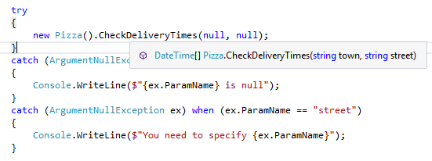
Colorized Tooltips

Slide 16
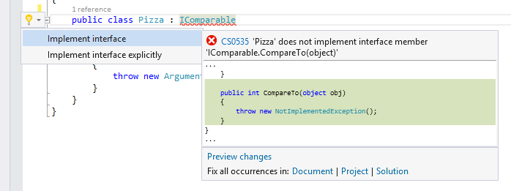
Code Fixes

Slide 17
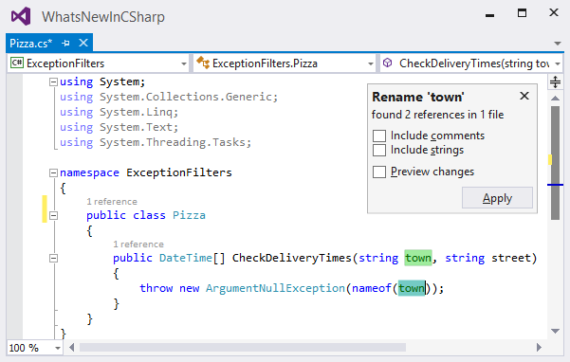
Refactoring

Slide 18
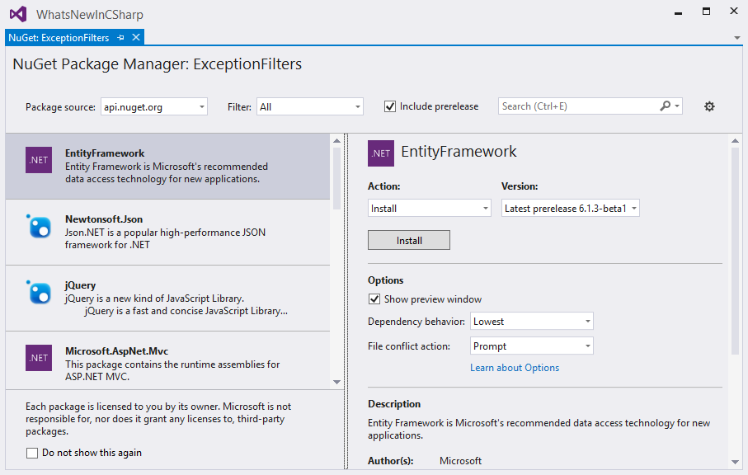
New NuGet UI

Slide 19
Analysis and Debugging
Intellitrace Events
Memory Usage
CPU Monitoring
Code Map Improvements

Slide 20
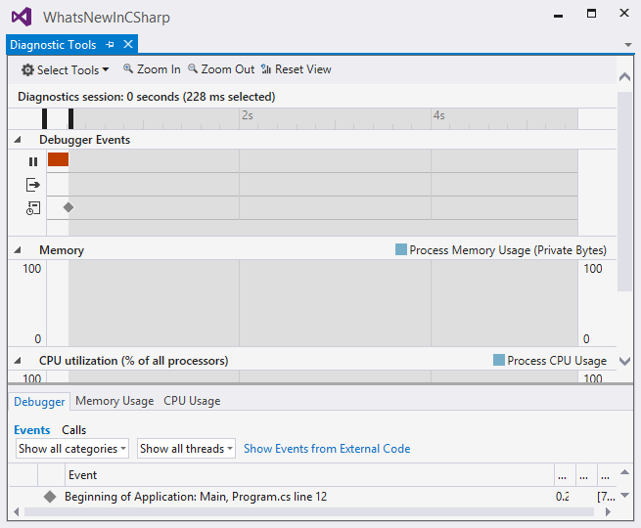
The New Diagnostics Window

Slide 21
Questions?
Joe Mayo
Twitter: @JoeMayo
Email: jmayo@mayosoftware.com
Code: https://github.com/JoeMayo

